Slide 1
Digital Portfolio
STUDENT NAME: DHARSHINI K
REGISTER NO AND NMID: asbru092422k2241
DEPARTMENT: Bsc. Computer Science
COLLEGE: COLLEGE/ UNIVERSITY Govt Arts College,Bharathiyar University

Slide 2
PROJECT TITLE
Interactive portfolio using
Front end Web development

Slide 3


AGENDA
Problem Statement
Project Overview
End Users
Tools and Technologies
Portfolio design and Layout
Features and Functionality
Results and Screenshots
Conclusion
Github Link
3/21/2024 Annual Review

Slide 4

PROBLEM STATEMENT
“How can I create a simple, modern, and responsive personal portfolio website that works well on both desktop and mobile, and lets me showcase my skills, hobbies, projects, and contact details?” HTML → solves the problem of structure & content (what to show). CSS → solves the problem of design & responsiveness (how it looks, mobile-friendly). JS → solves the problem of interaction (hamburger menu toggle, smooth navigation).

Slide 5

PROJECT OVERVIEW
This project is about creating a personal portfolio website for Dharshini. The website shows her introduction, skills, hobbies, projects, and contact details in a clean and modern design. It is responsive, meaning it works well on both mobile and desktop devices. The site also has an interactive navigation menu for easy access to different sections. The main goal is to provide an online space where Dharshini can showcase her creativity, coding skills, and artwork, while also giving others a simple way to contact her.

Slide 6

WHO ARE THE END USERS?
The end users of this portfolio website are: 1. Teachers & Professors – to review Dharshini’s projects, skills, and creativity. 2. Future Employers / Recruiters – to check her abilities, projects, and contact details for career opportunities. 3. Friends & Classmates – to explore her hobbies, drawings, and writings. 4. General Visitors – anyone who wants to know about Dharshini’s talents and contact her.

Slide 7

TOOLS AND TECHNIQUES
Tools Used: HTML5 → to create the structure of the website (content & sections). CSS3 → to design the layout, colors, responsiveness, and styles. JavaScript → to add interactivity (menu toggle, smooth navigation). VS Code (or any code editor) → for writing and editing the code. Browser (Chrome/Edge/Firefox) → to test and view the website Techniques Used: Responsive Web Design → makes the site work on mobile, tablet, and desktop. Flexbox & Grid → for neat alignment of sections and projects. Sticky Navbar + Hamburger Menu → for easy navigation. Form Handling (Contact Section) → to let users send a message. Hover Effects & Transitions → to make the site interactive and modern.

Slide 8
POTFOLIO DESIGN AND LAYOUT
Navbar (Top Menu): A dark sticky navigation bar at the top with links to different sections. On smaller screens, it changes into a hamburger menu for mobile users. Home Section: A welcoming banner with Dharshini’s name, introduction, and a colorful gradient background. About Section: A simple section that describes skills and hobbies in list format for quick reading. Projects Section: Displays projects in card style layout using a responsive grid so that projects adjust neatly on desktop and mobile. Contact Section: Provides phone, email, education details, and a contact form where users can send messages. Footer: A small footer with copyright and a creative touch.
8

Slide 9
FEATURES AND FUNCTIONALITY
Features and Functionality 1. Responsive Design – The website works smoothly on desktops, tablets, and mobile phones. 2. Navigation Bar – A sticky top menu that helps users quickly move to different sections. On mobile, it becomes a hamburger menu. 3. Home Section – A welcoming introduction with Dharshini’s name and short description. 4. About Section – Shows skills, hobbies, and personal interests in a clear way. 5. Projects Section – Displays projects in a card style layout with images and descriptions. 6. Contact Section – Includes phone, email, education details, and a contact form for users to send messages. 7. Interactive UI – Hover effects, smooth transitions, and clickable links make the site user-friendly. 8. Footer Section – A simple closing section with copyright and a creative touch.

Slide 10
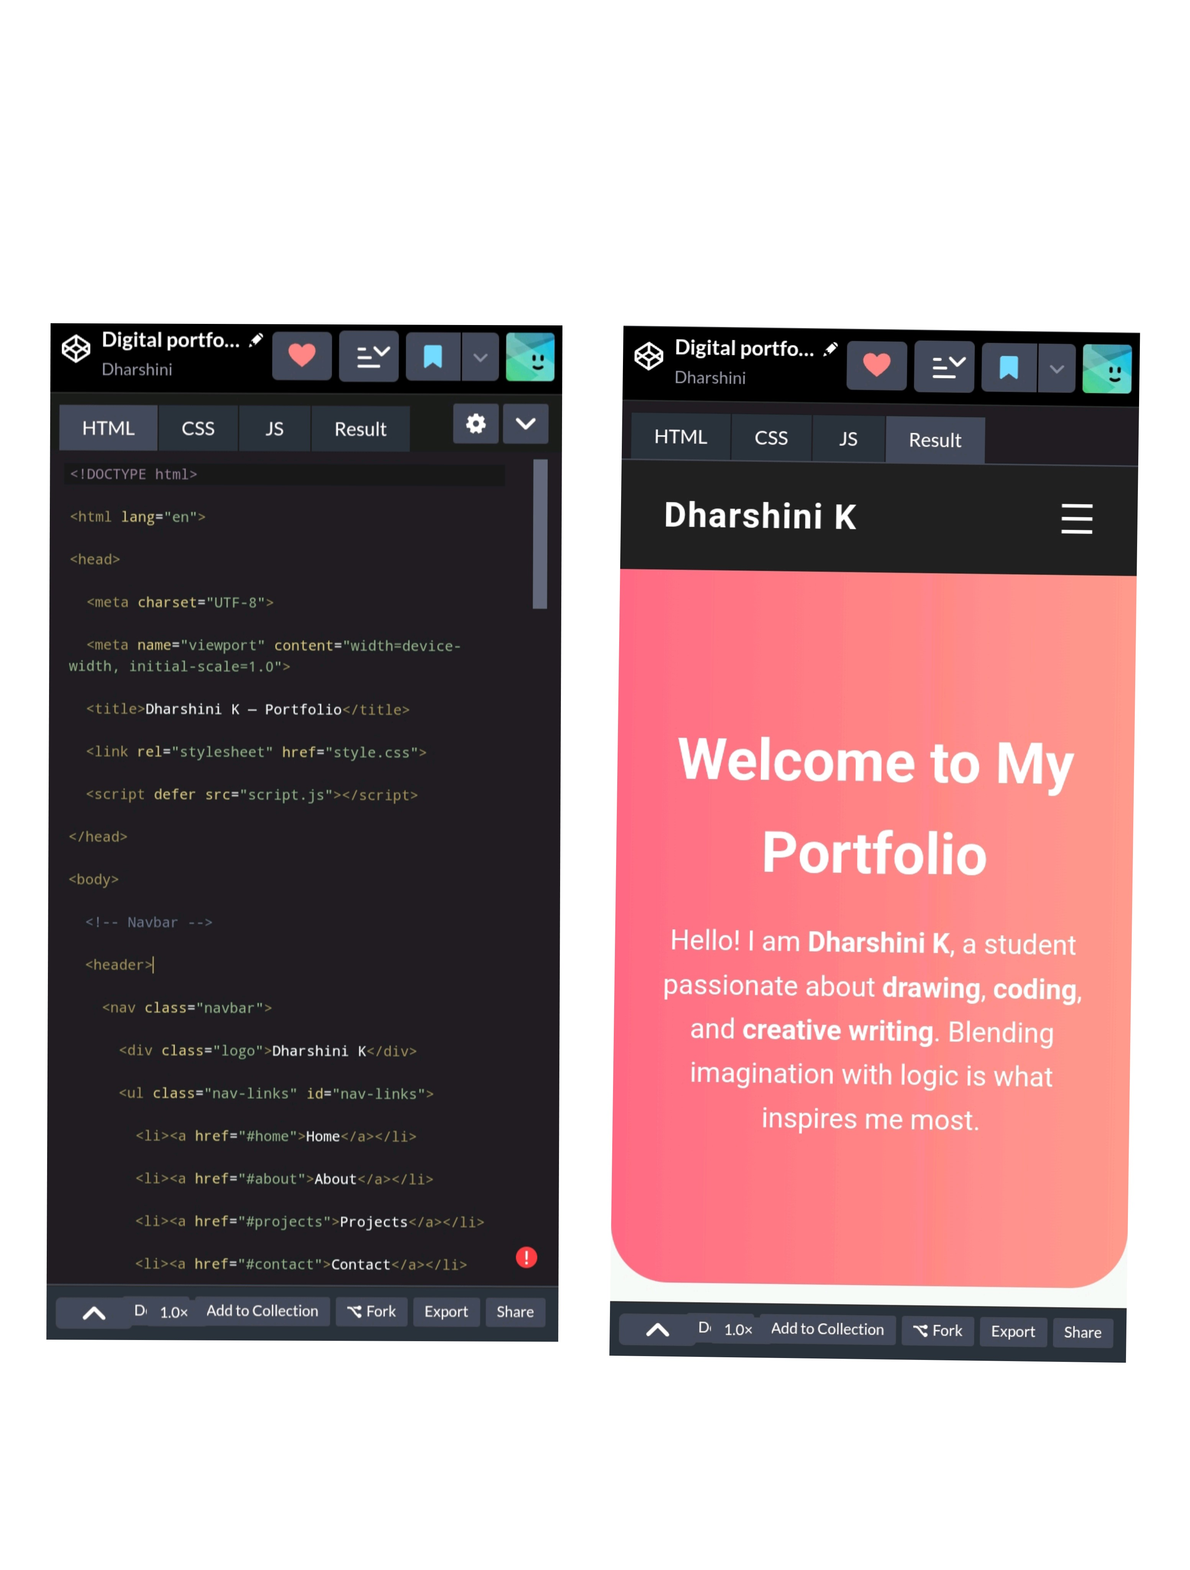

RESULTS AND SCREENSHOTS
3/21/2024 Annual Review
10

Slide 11
CONCLUSION
The personal portfolio website is a responsive, creative, and user-friendly platform that showcases Dharshini’s skills, hobbies, and projects in an organized way. By combining HTML, CSS, and JavaScript, the site not only provides information but also ensures smooth navigation and interactivity. This project successfully demonstrates how creativity (art, writing, drawing) and technology (coding, web design) can be merged into one place. The portfolio will help Dharshini present her work to teachers, friends, and future employers, making it a valuable step towards her career and personal growth.
11

